Slide 1
Fuzzy logic application
Aircraft landing control

Slide 2
What is fuzzy logic?
Used in areas of uncertainty or fuzziness in real world systems
Efficient way of dealing with this fuzziness is by the mechanism of fuzzy logic
Ease of implementation and robustness, FLC is increasingly growing in popularity

Slide 3
Aircraft Landing Control Problem
Calculation of the final descent and landing approach of an aircraft
The desired downward velocity is proportional to the square of the height. Thus, at higher altitudes, a large downward velocity is desired
As the height (altitude) diminishes, the desired downward velocity gets smaller and smaller
In the limit, as the height becomes vanishingly small, the downward
velocity also goes to zero
In this way, the aircraft will descend from altitude promptly but will touch down very gently to avoid damage

Slide 4
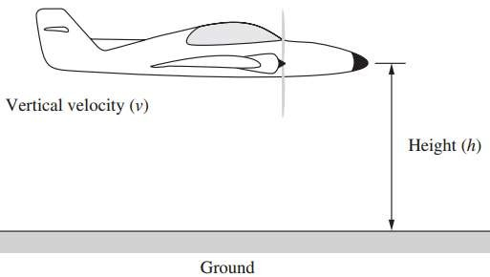
The two state variables for this simulation will be the height above
ground “h” , and the vertical velocity of the aircraft “v”

Slide 5

Control output will be a force, that when applied to the aircraft will alter its height h and velocity v
If no external force is applied, the mass m will continue in the same direction at the same velocity v
If a force f is applied over the time t then a change in velocity occurs,

Slide 6
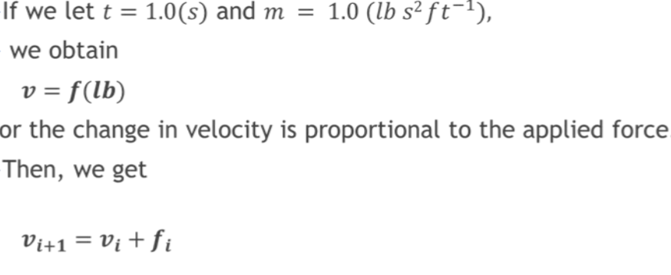

Slide 7
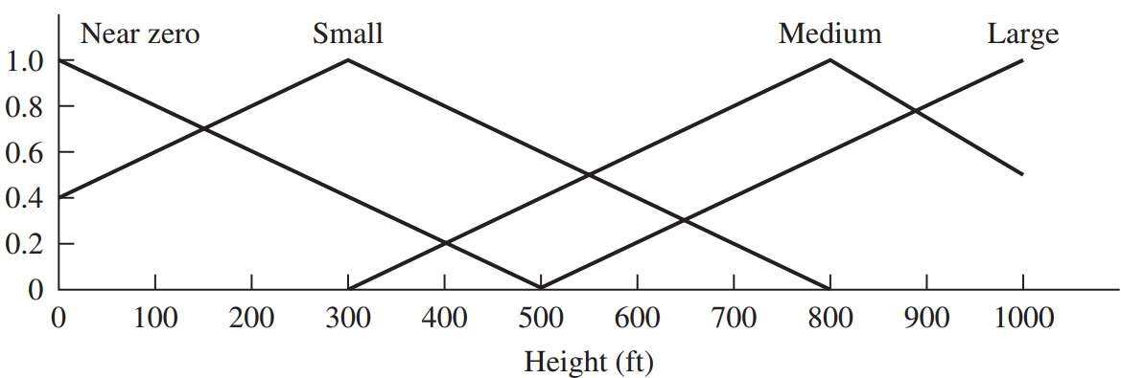
Membership value for height
 | Height (ft.)
 | 0 | 100 | 200 | 300 | 400 | 500 | 600 | 700 | 800 | 900 | 1000
Large (L) | 0 | 0 | 0 | 0 | 0 | 0 | 0.2 | 0.4 | 0.6 | 0.8 | 1
Medium (M) | 0 | 0 | 0 | 0 | 0.2 | 0.4 | 0.6 | 0.8 | 1 | 0.8 | 0.6
Small (S) | 0.4 | 0.6 | 0.8 | 1 | 0.8 | 0.6 | 0.4 | 0.2 | 0 | 0 | 0
Near Zero (NZ) | 1 | 0.8 | 0.6 | 0.4 | 0.2 | 0 | 0 | 0 | 0 | 0 | 0
Membership
value

Slide 8
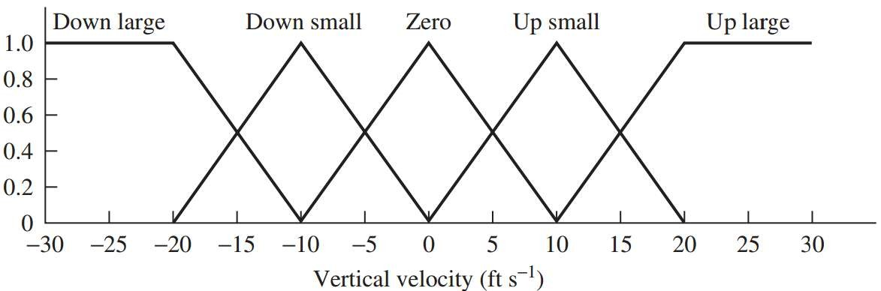
Membership value for velocity
 | Height (ft.)
 | -30 | -25 | -20 | -15 | -10 | -5 | 0 | 5 | 10 | 15 | 20 | 25 | 30
Up large (UL) | 0 | 0 | 0 | 0 | 0 | 0 | 0 | 0 | 0 | 0.5 | 1 | 1 | 1
Up small (US) | 0 | 0 | 0 | 0 | 0 | 0 | 0 | 0.5 | 1 | 0.5 | 0 | 0 | 0
Zero (Z) | 0 | 0 | 0 | 0 | 0 | 0.5 | 1 | 0.5 | 0 | 0 | 0 | 0 | 0
Down small (DS) | 0 | 0 | 0 | 0.5 | 1 | 0.5 | 0 | 0 | 0 | 0 | 0 | 0 | 0
Down large (DL) | 1 | 1 | 1 | 0.5 | 0 | 0 | 0 | 0 | 0 | 0 | 0 | 0 | 0
Membership
value

Slide 9
Membership values for control force
 | Height (ft.)
 | -30 | -25 | -20 | -15 | -10 | -5 | 0 | 5 | 10 | 15 | 20 | 25 | 30
Up large (UL) | 0 | 0 | 0 | 0 | 0 | 0 | 0 | 0 | 0 | 0.5 | 1 | 1 | 1
Up small (US) | 0 | 0 | 0 | 0 | 0 | 0 | 0 | 0.5 | 1 | 0.5 | 0 | 0 | 0
Zero (Z) | 0 | 0 | 0 | 0 | 0 | 0.5 | 1 | 0.5 | 0 | 0 | 0 | 0 | 0
Down small (DS) | 0 | 0 | 0 | 0.5 | 1 | 0.5 | 0 | 0 | 0 | 0 | 0 | 0 | 0
Down large (DL) | 1 | 1 | 1 | 0.5 | 0 | 0 | 0 | 0 | 0 | 0 | 0 | 0 | 0
Membership value

Slide 10
Fuzzy associative memories (FAM) table
 | Velocity
Height | DL | DS | Zero | US | UL
L | Z | DS | DL | DL | DL
M | US | Z | DS | DL | DL
S | UL | US | Z | DS | DL
NZ | UL | UL | Z | DS | DS

Slide 11
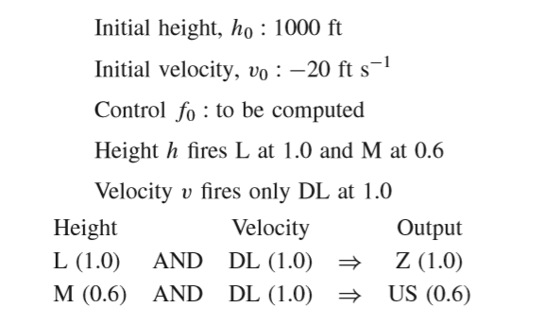

Slide 12
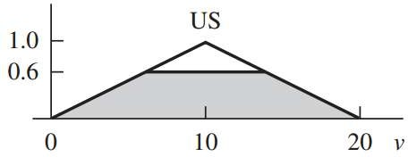
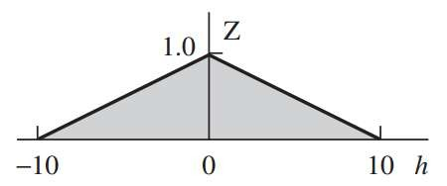
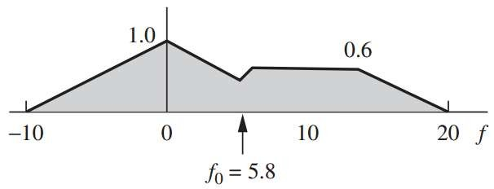

Slide 13
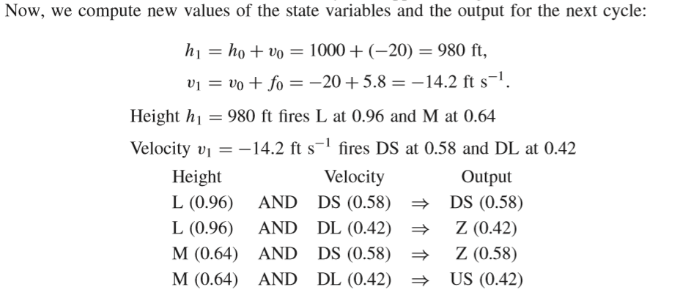

Slide 14
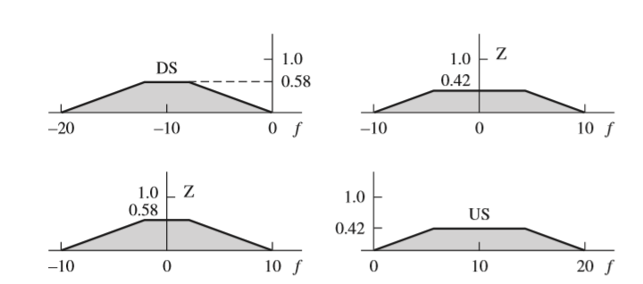

Slide 15
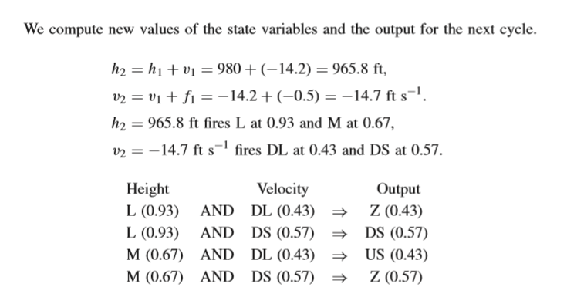
Cycle 2

Slide 16
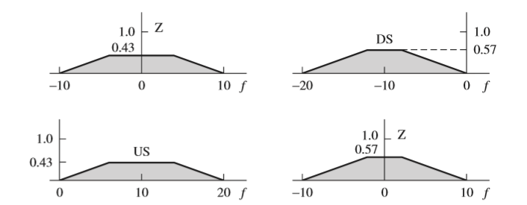

Slide 17
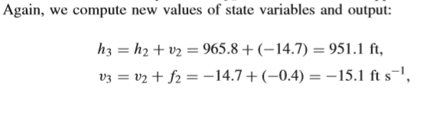
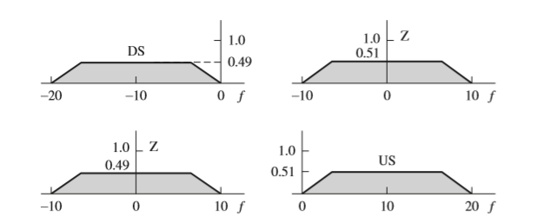

Slide 18
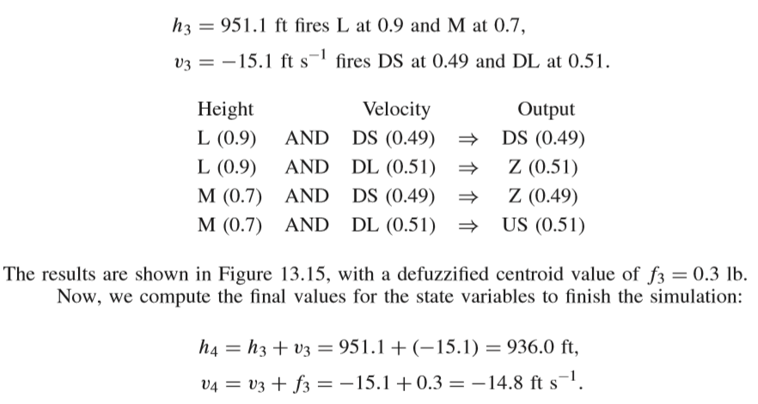

Slide 19
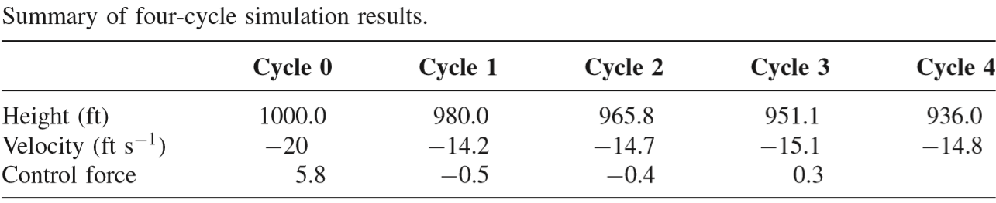
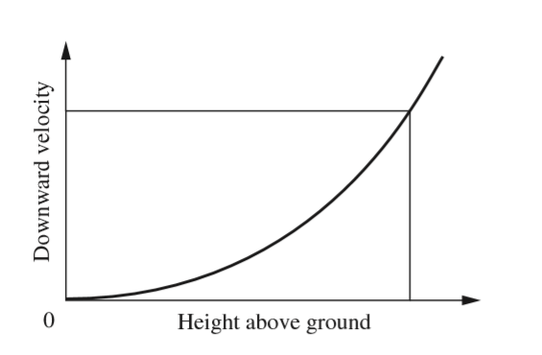

Slide 21
References…
Ross, T.J., 2010, Fuzzy Logic With Engineering Applications, 3rd edition, John Wiley & Sons, Ltd..
Narendra Kumar et al., “Control of Aircraft Landing Using Fuzzy Logic ,” International Journal of Emerging Trends in Engineering and Development, 2013.

